Slide 1
Welcome To
The Masters Breakfast
How To Survive In Relationships
Speaker - Benjamin Jones
Special Guest

Slide 2
You Really Can Bring Your Relationship Back Full Circle!
It Starts With
U !

Slide 3
Communication
In Marriage

Slide 4
Divorce Rate In America
50/60% None Church
35% Church Members
.06% of Believers Who Pray Together
Stay Together

Slide 5
Effective Communication
It’s Not My Fault It’s Your Fault

Slide 6
Communication
Effective Communication is the Cornerstone of any Successful Relationship.
Whether it’s a Romantic Partnership, Friendship, or Family Bond or Business, how we Express Ourselves and Listen to Others Profoundly Impacts our Connections.

Slide 7
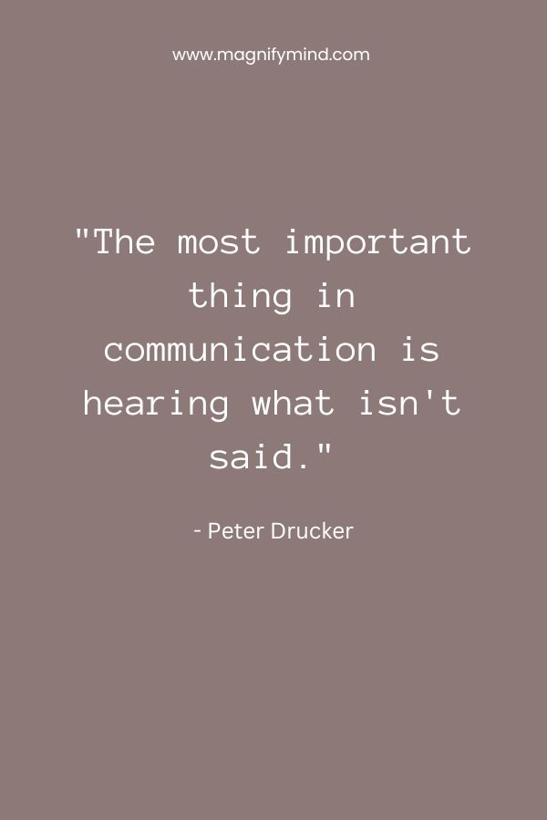
Power of Love:
50 Inspirational Communication in Relationship Quotes (magnifymind.com)

Slide 8
Thank You For Coming
See You Next Week
Tuesday at 9:00
God Bless
www.TheMastersBreakfast.com

Slide 9
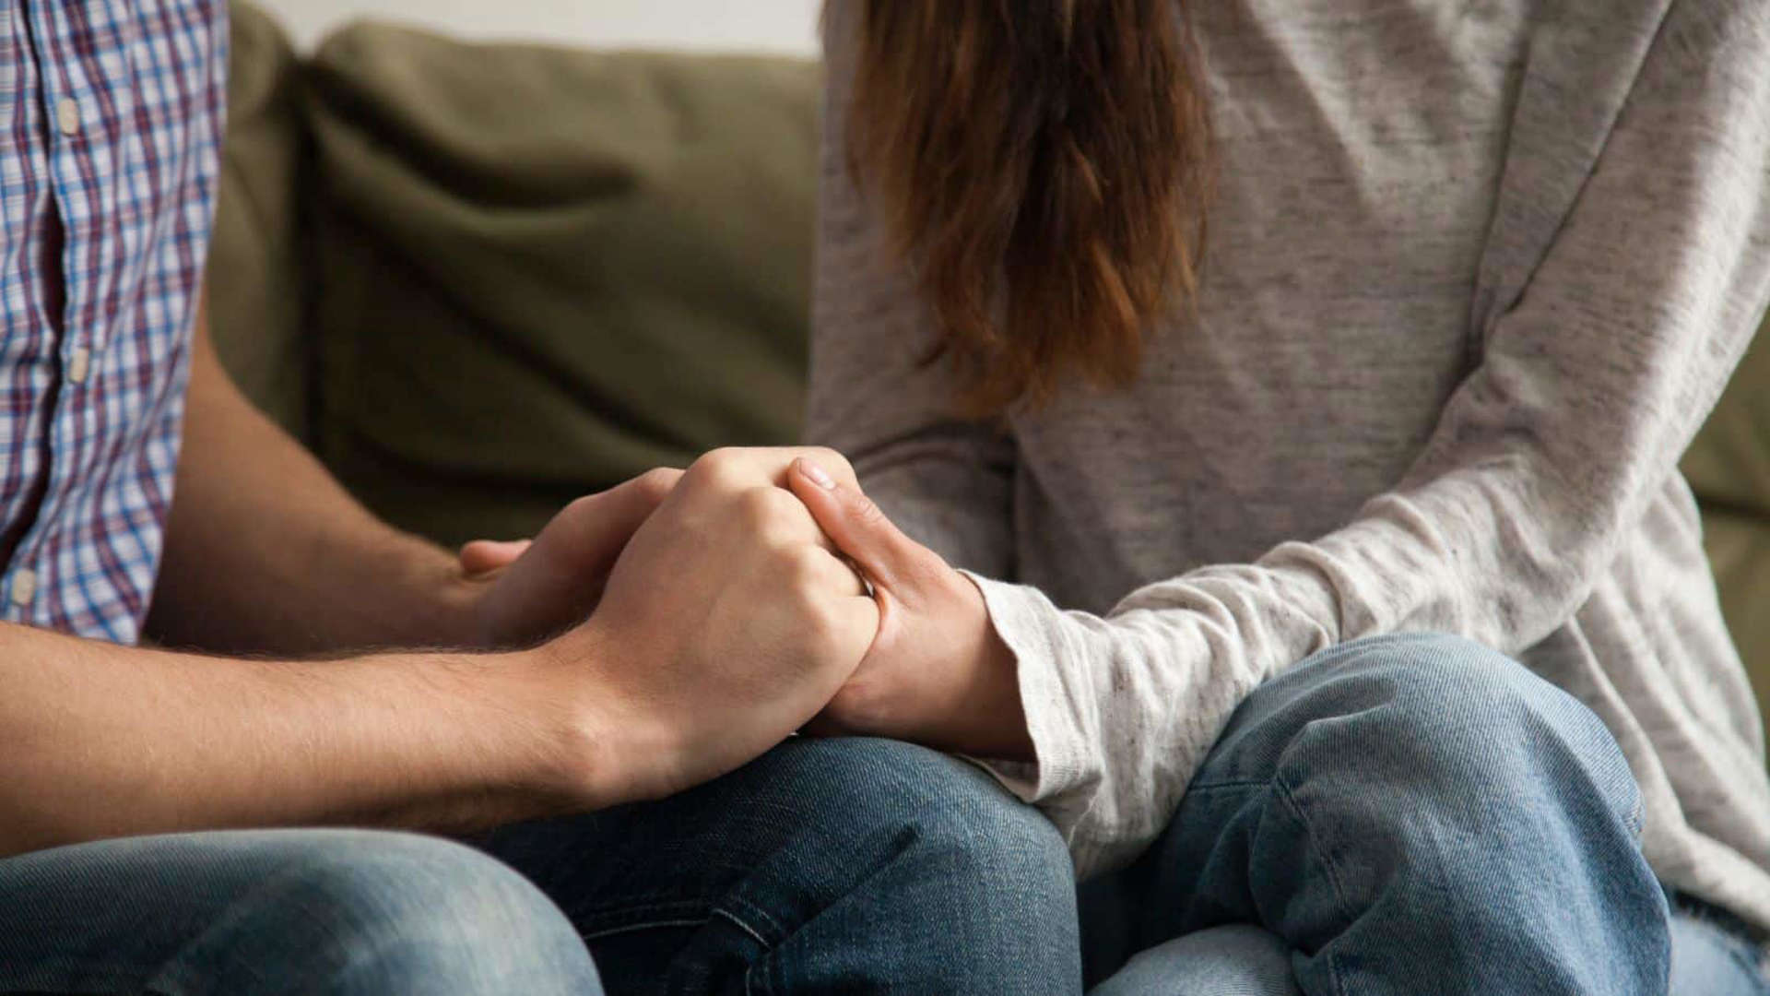

Slide 10
Forgiveness

Slide 12
Companionship

Slide 14
Understanding

Slide 16
Learning To Get Along

Slide 18
Unconditional Love

Slide 20
Understanding The Word Commitment

Slide 22
Obedience To Gods Word

Slide 24
Acts Of Sharing

Slide 25
Learning How To Grow In Knowledge Together

Slide 26
Compassion For The Other Persons Feelings

Slide 27
Freedom To Express Yourself

Slide 28
Willing To Change

Slide 29
Willing To Listen

Slide 30
Cannot Be Indifferent To Hearing What Is On The Other Persons Mind
In Other Words :
Have An Open Mind

Slide 31
Patience

Slide 32
Apply What The Bible Teaches

Slide 33
Apply The Fruits Of The Spirit In Your Life

Slide 34
Pray Together Stay Together

Slide 35
Putting God First
In Your Life!

Slide 36
Thank You For Coming
See You Next Week
Tuesday at 9:00
God Bless
www.TheMastersBreakfast.com

