Slide 1
Welcome To
The Masters Breakfast
Science Supports That
God Created The Universe
Speaker - Benjamin Jones

Slide 2
Science Supports that God Created the Universe

Slide 3
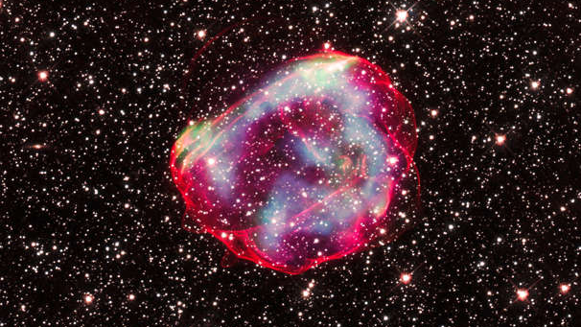

Slide 4
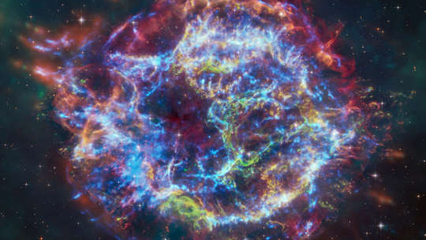

Slide 5
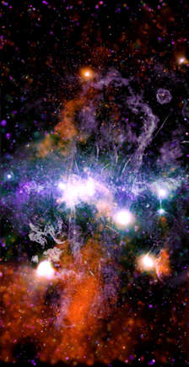

Slide 6
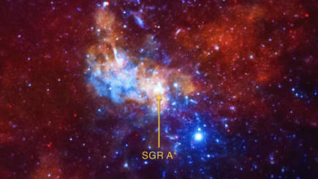

Slide 7
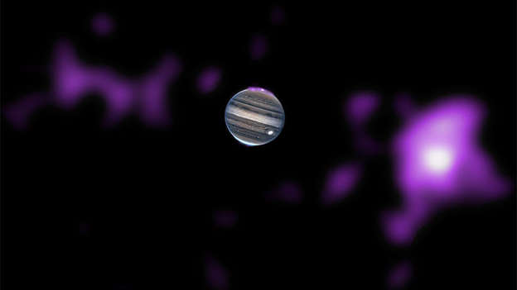

Slide 8
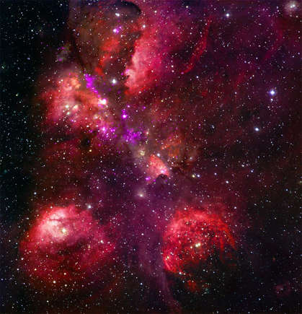

Slide 9
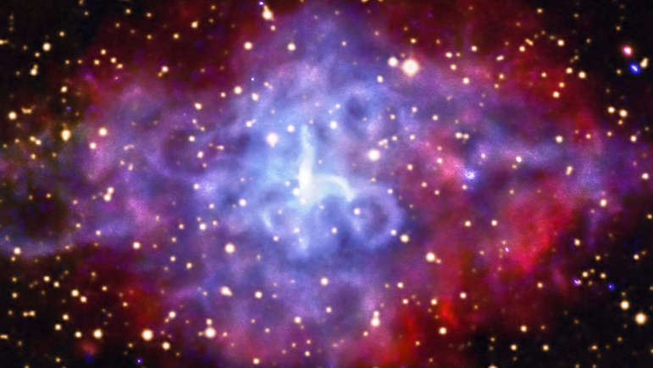

Slide 10
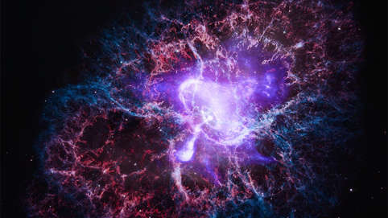

Slide 11
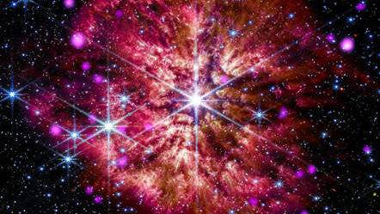

Slide 12
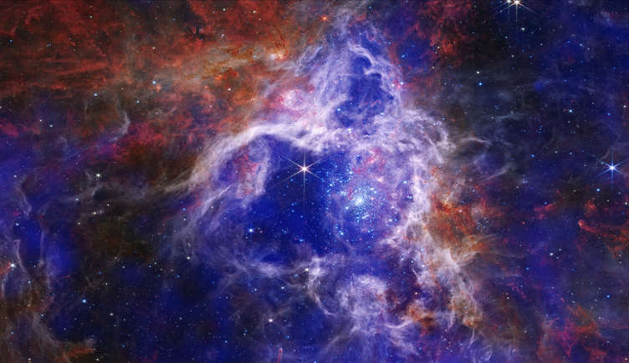

Slide 13
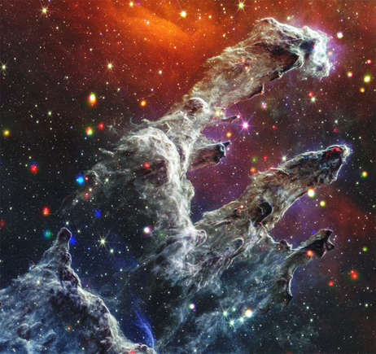

Slide 14
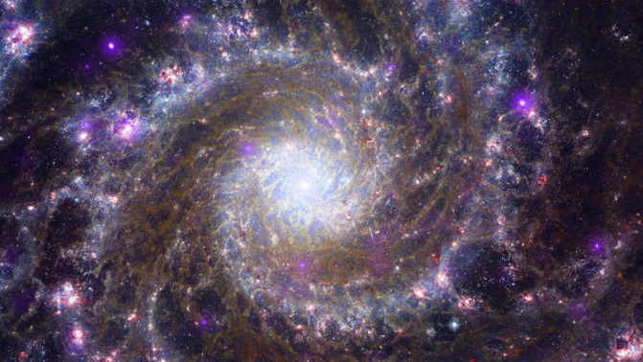

Slide 15
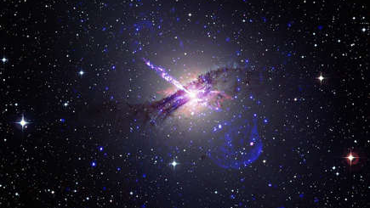

Slide 16
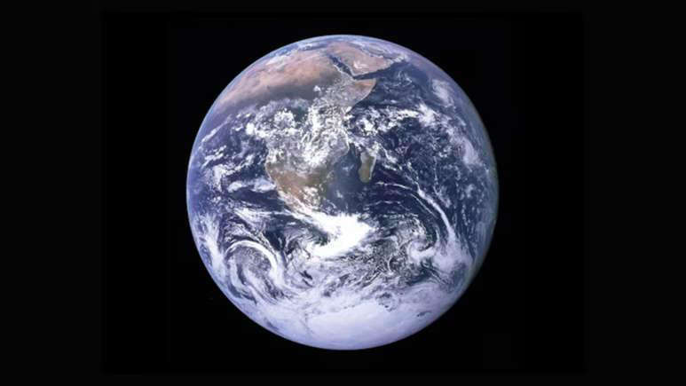

Slide 17
There has been , while skeptics claim that Science can Explain Everything However, Major Scientific Discoveries of the Twentieth Century actually point to the Possibility of a Divine Creator. Perhaps Science and Religion do not need to contradict each other, but instead help us to thoroughly explore, Our Universe.

Slide 18
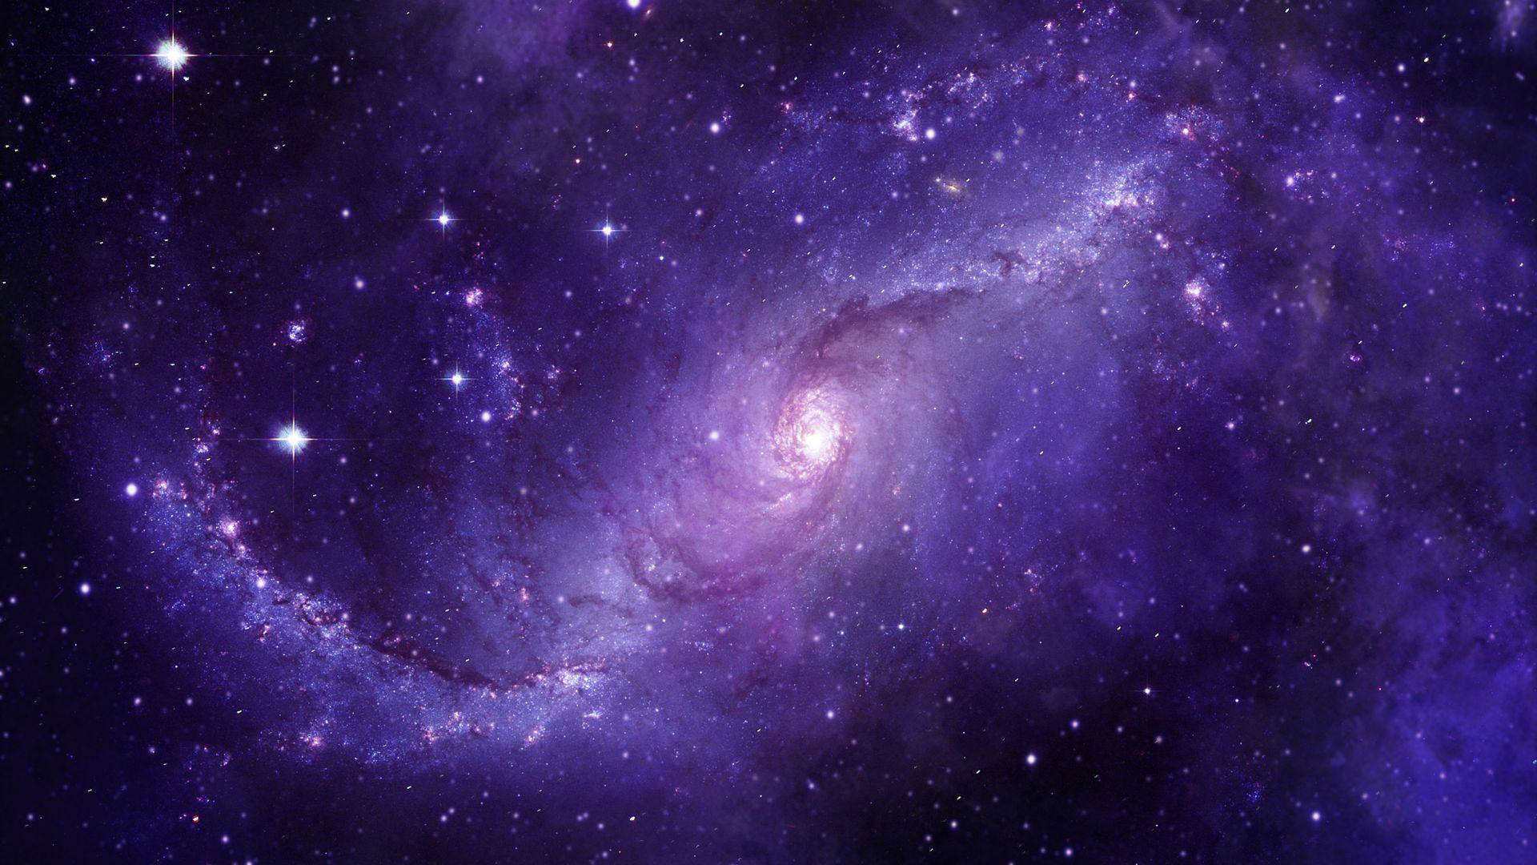
Cosmic Beginnings
Pillars of Creation Seen In 4K Via James Webb Space Telescope | Watch (msn.com)

Slide 19
Scientists have discovered that our Universe Had a Beginning! At Once, It Existed! This discovery contradicts the long-standing beliefs of many skeptics that the universe is eternal and self-existent.
Georges Lemaître and Edwin Hubble Proved to the Scientific Community that the Universe is Expanding, so therefore, it must have Started at a
Certain Moment In Time.

Slide 20
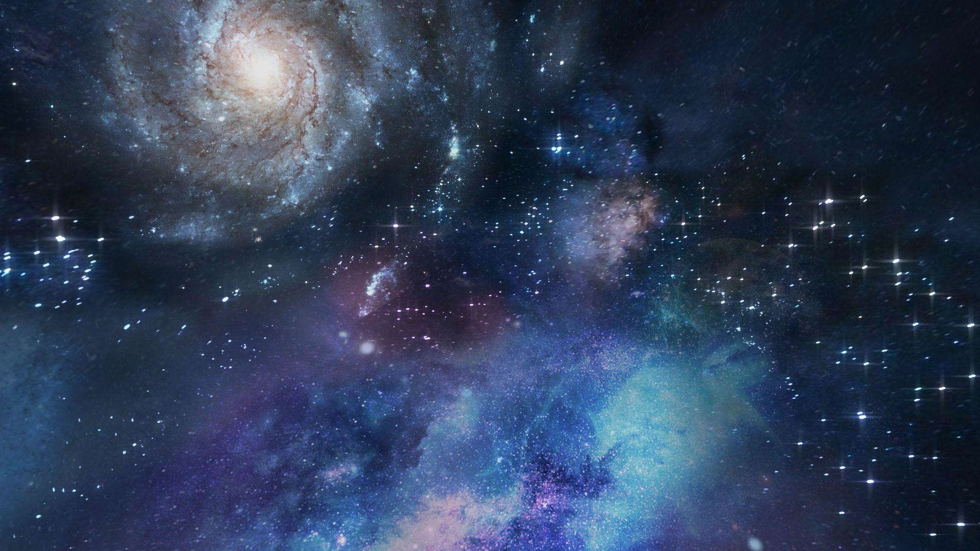
A Redshifting Universe
NASA James Webb telescope shows Penguin and Egg galaxies (usatoday.com)

Slide 21
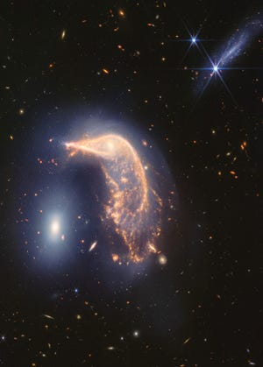
NASA James Webb telescope shows Penguin and Egg galaxies (usatoday.com)

Slide 22
Lemaître and Hubble discovered the continuous expansion of the universe by studying Redshift. According to Britannica, Redshift is “Displacement of the Spectrum of an Astronomical Object toward longer (Red) wavelengths… It is attributed to the Doppler effect, a Change in Wavelength that results when a given source of waves… and an observer are in motion with respect to each other.”
Essentially, by observing Redshift in Distant Galaxies, Lemaître and Hubble discovered that galaxies are moving away from the Earth, implying that the universe is expanding outwards. Additionally, galaxies that are farther from Earth move away faster than those that are closer.

Slide 23
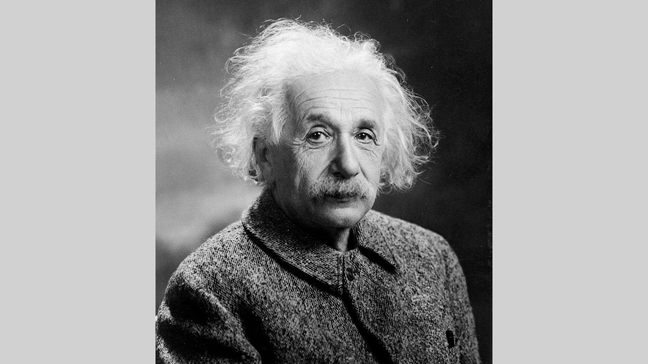
Einstein described his initial refusal to accept the idea of an expanding universe as “the greatest blunder”
of his career.
Convincing
Einstein

Slide 24
For many years, famous Scientist Albert Einstein did not believe in an expanding universe; his calculations supported a static one. However, he began to change his mind once meeting with Hubble.
In 1931, Einstein met with Hubble and reviewed his and Lemaître’s Redshift Evidence. Upon recognizing this amazing new discovery, Einstein described his initial refusal to accept the idea of an expanding universe as “the greatest blunder” of his career.

Slide 25
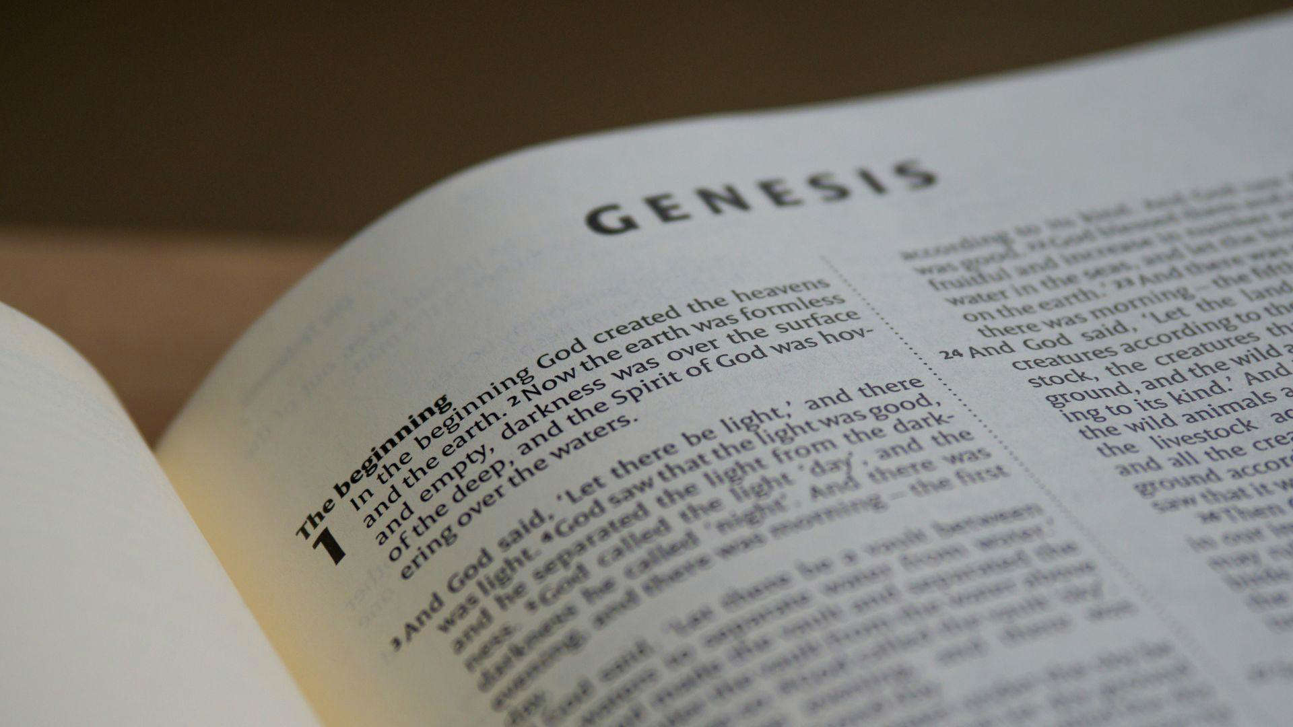
Consistent with the Bible

Slide 26
A Universe with a Starting Point Suggests that A God Created It. Nobel Laureate Arno Penzias agreed that the idea of the Universe Beginning at once is Consistent with Biblical Descriptions.
Therefore, Redshift evidence points to the suggestion that God—An External, Divine Creator—Fashioned The Universe Purposefully From Nothing.

Slide 27
A Goldilocks Universe

Slide 28
Physicists Describe our Earth, our Galaxy, and consequently, Our Universe, as a “Goldilocks Universe.” It is “Just Right” to “Support Life”. There are Infinite Fundamental Physical Laws & Parameters Precisely Set in Order to Make Life Possible. Amen
Even Small Changes to Gods laws of His Universe Would Render Life Impossible. If the gravitational strength of the Earth, masses of certain particles, or amounts of certain essential elements were different,
we wouldn’t be able to live.

Slide 29
God Created The World
For All Of Us

Slide 30
There are so many factors that go into the Survival of Our Society—and The Universe In General. The Exact Values of Physical Constants Are So Precise That It Is Amazing, UnBelievable. These Constants of Our Universe make life of any kind possible.
Sir Fred Hoyle, an Astronomer, claimed that a “Superintellect” must have Manipulated Physics to Enable Life.
Our existence is so unlikely that many scientists believe that some entity must have done it purposefully.

Slide 31
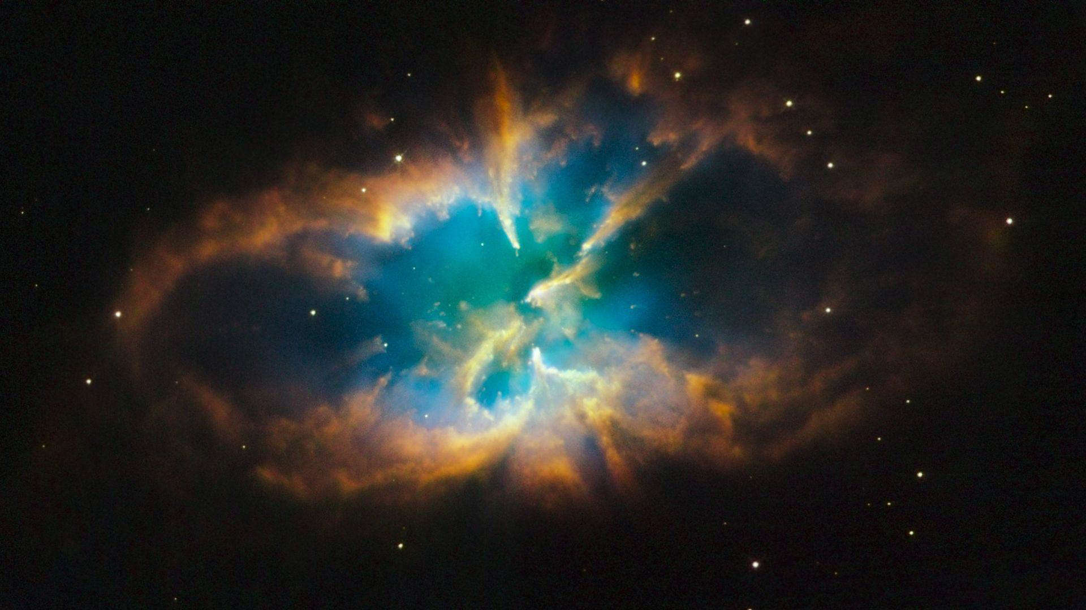
The Multiverse Theory…

Slide 32
Some religious skeptics propose the Multiverse Theory instead of accepting a Divine Creator and Fine-Tuner of The Universe. The Multiverse Theory claims that there are an infinite number of possible existences. Where Are They?
According to those who believe in the Multiverse, our universe is just one of the literally Infinite Universes where the Conditions are just right to enable life!

Slide 33
…And Why it is Unlikely

Slide 34
There are many issues with the Multiverse Theory. First, the Multiverse theory does not explain Redshift or how Our Universe came To Exist. Therefore, the Multiverse Theory itself still does not escape the need for fine-tuning, which points back to a God Creating The Universe (or perhaps many universes).
The scientific mechanisms that have been proposed by physicists, whether inflationary cosmology or string theory, still require Extremely Precise settings. Unless every single universe is somehow completely random and we just so happen to be in a self-sufficient universe that is miraculously perfect for life,
There Is Still A Required Creator.

Slide 35
DNA Structure

Slide 36
DNA is another place we can look to see God's work. In 1953, James Watson and Francis Crick’s research on DNA structure led to the:
“Sequence Hypothesis.”
DNA works like a written language or computer code. This is an Observable Phenomenon. Specific sequences of Code In DNA make up quite literally
Every Living Thing.

Slide 37
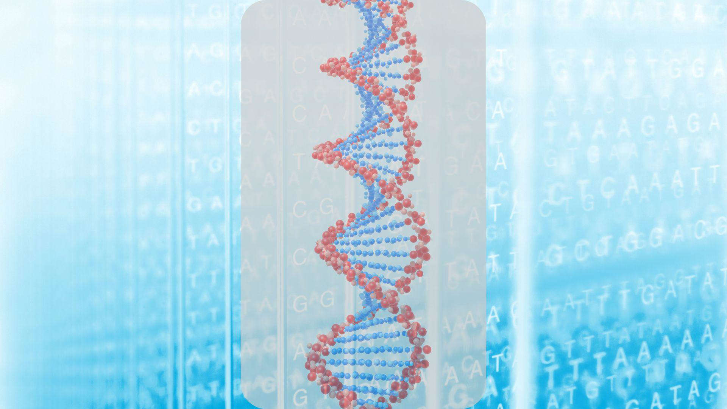
Programming DNA’s Code

Slide 38
DNA is very code-like, which implies that someone programmed it. Founder of Microsoft, Bill Gates, compared DNA to A-Highly Advanced Software far Beyond Human Technology.
DNA is a highly complex system and we Barely Understand It. No theory of undirected chemical evolution can explain DNA’s extremely complex informational content. We have no idea why DNA does what it does. Therefore, it seems that It (DNA) was made by an Intelligent & Divine Creator who Programmed It (DNA)in A Certain Way.

Slide 39
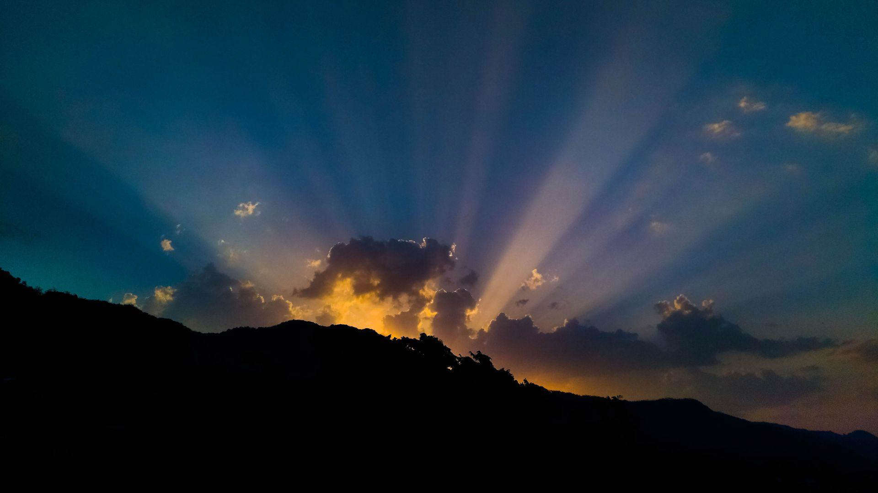
Intelligent Design, Creator, God

Slide 40
A medical doctor named Henry Quastler once said that “information habitually arises from Conscious Activity.”
Information originates with A Creator.
Between Redshift proving The Beginning Of The Universe, to the extreme specificity of our Goldilocks Galaxy, to the Complex and Incomprehensible Coding of DNA, it really seems like –
There is an Supper Intelligent Creator Who Made Life As We Know It.

Slide 41
Thank You For Coming
See You Next Week
Tuesday at 9:00
God Bless
www.TheMastersBreakfast.com

Slide 42
This Young Lady Hits The Nail On The Head
Wake Up America

